Slide 1

Data-Driven Insights on Telangana Vehicle Market (2019–2025)
Name: Veda Meghana
PGDM (Data Science and Business Analytics)

Slide 2
PROJECT OVERVIEW
OBJECTIVE : Analyse Vehicle registration trends in Telangana
DATA SOURCE : Telangana RTA (Jan 2019 – June 2025)
TOOLS USED : Excel, Python, SQL, Power BI, ML Models
FOCUS : EV Market trends and Future Predictions

Slide 3
PROJECT OVERFLOW SUMMARY
PHASE 1
Conducted EDA
Analysed Vehicle types, Fuel categories, brand popularity, District and Zone wise analysis
Built interactive Power BI Dashboard
PHASE 2
Filtered data for Fuel = EV
Performed detailed EDA
Built interactive Power BI Dashboard
PHASE 3
Predicted
Total EV Registrations for 2025 + 2026
District wise EV adoption for 2026
2. Used ML Models: Linear regression, Random Forest

Slide 4
Raw Dataset & Data Cleaning
RAW DATASET
CLEANED DATASET
S.NO
Model Description
Fuel
Colour
Vehicle class
Maker Name
Make year
Seat capacity
Second vehicle
Temp Reg Number
Category
Office code
From date
End date
S.NO
Fuel
Fuel Category(Traditional- Petrol, Diesel, CNG, EV- Battery, Dual Fuel- CNG Petrol, LPG Petrol, Hybrid- Petrol Electric)
Vehicle Class
Vehicle class category (Private, commercial, special)
Manufacture Date
Seat Capacity
Brand
Reg Office
District
Zone
Reg Date
Month
Year
Cleaning & Transformation
✅ Kept only meaningful & analysable columns
✅ Removed irrelevant, duplicate, and confusing fields
✅ Created new derived columns for insights & modelling
❌ Dropped Columns
Model Description, Color, End Date, Category, Temp Reg. Number, Second Vehicle
📌 Reason: Redundant, inconsistent, or not useful for analysis

Slide 5
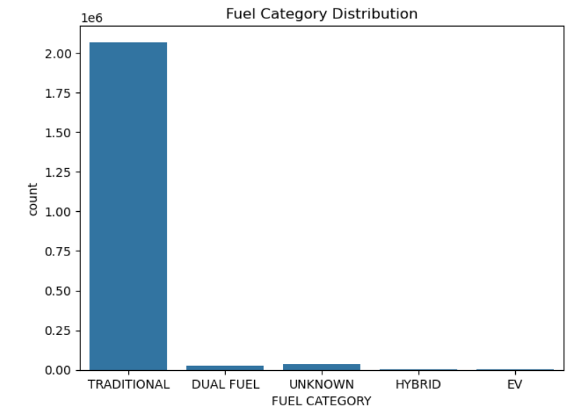
EDA Insights – 2019 Overall Vehicle Data
Combined all the sheets ( January to December)
Length - 21,31,843
Converted data types
Null values as unknown
Fuel category
→ Total registrations by fuel type category Dominated by Traditional fuels (Petrol, Diesel, CNG)
→ EVs form a very small fraction (0.11%)
→ Telangana in 2019 was heavily traditional fuel dependent EVs were just beginning to appear

Slide 6
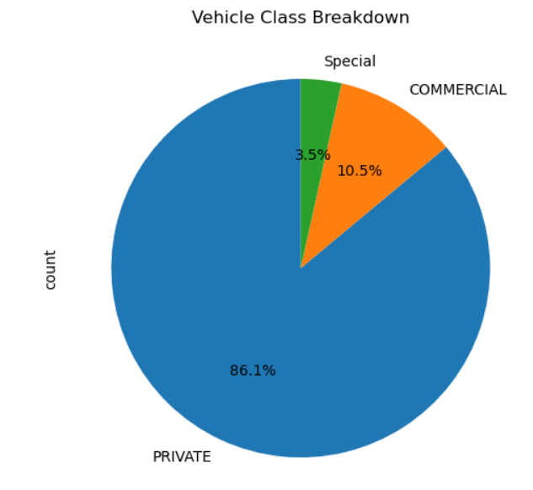
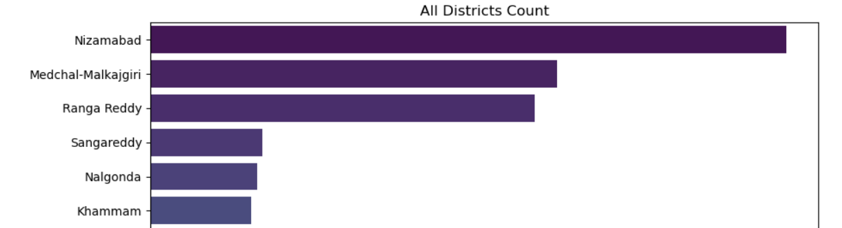
2. Vehicle class category
Breakdown of vehicle usage types Private vehicles form 86% of total
Commercial vehicles are around 13.5%
Special vehicles are very rare (0.24%)
Insight: Majority of vehicles are for private transport (cars, 2-wheelers)
3. Districts - 29(unique)
Top 5 - Nizamabad, Medchal, Rangareddy, Sangareddy, Nalagonda

Slide 7
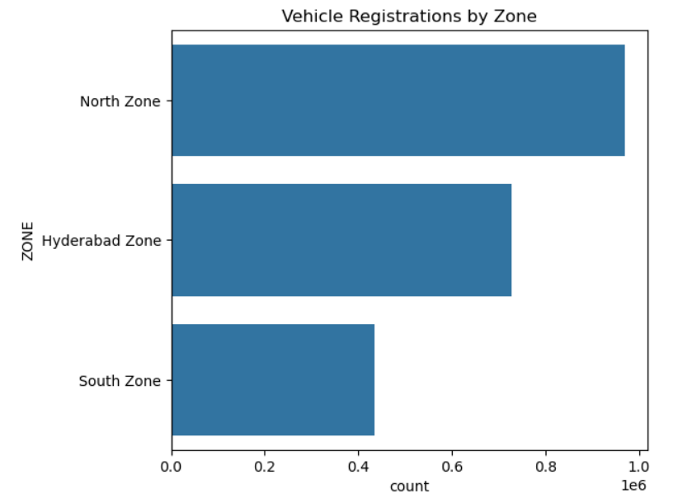
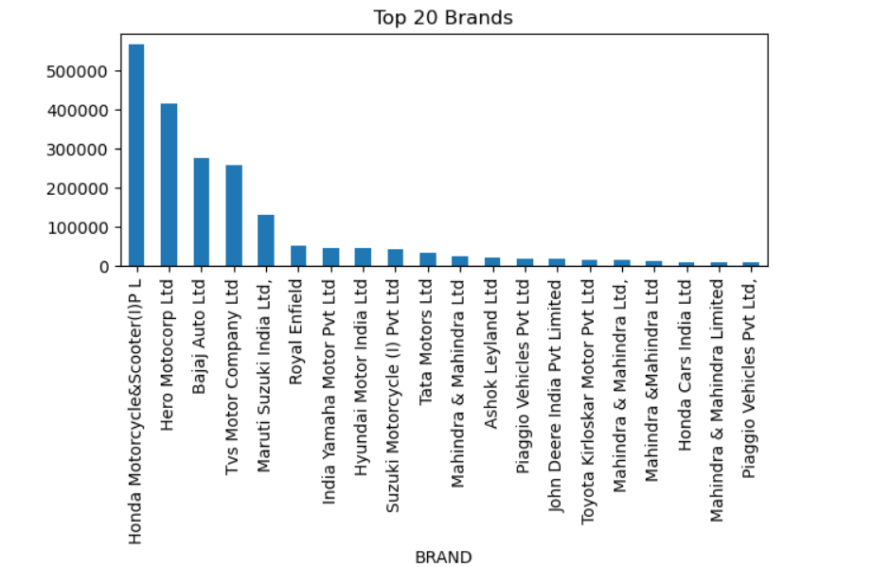
4. Zones
North > Hyderabad> south
5. Total unique brands (502)
Top 5 ---Honda Motorcycles and scooters, Hero Motorcorp, Bajaj Auto, TVS Motor company, Maruti Suzuki

Slide 8
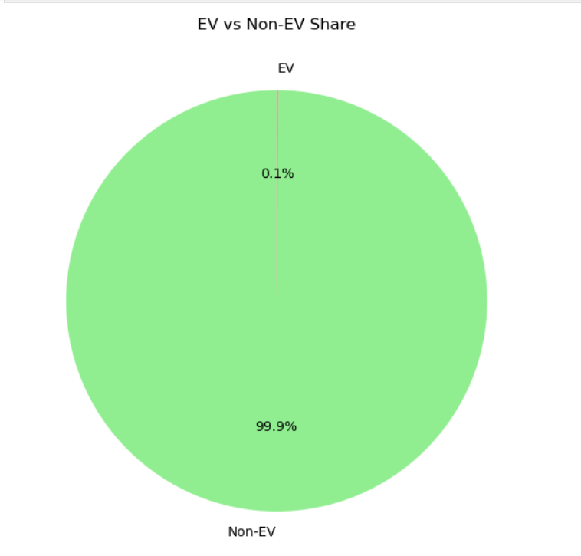
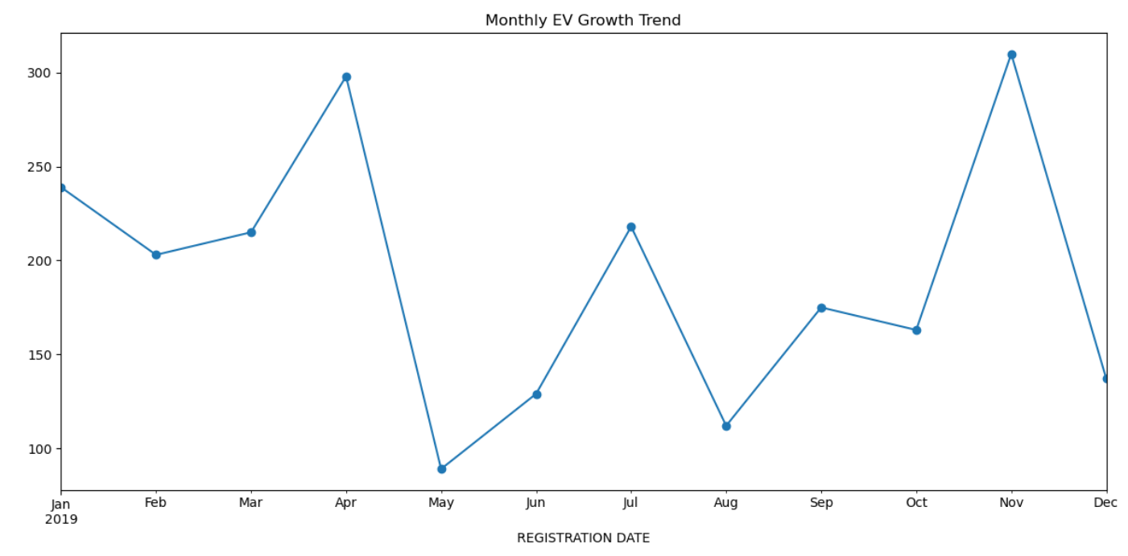
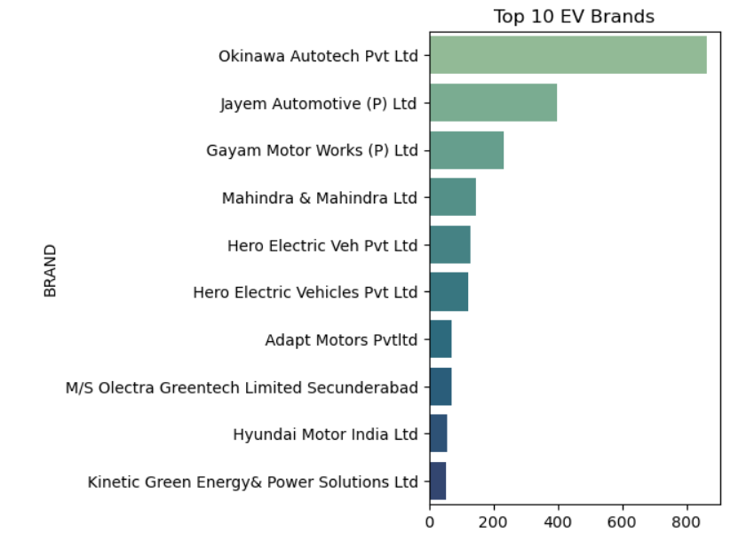
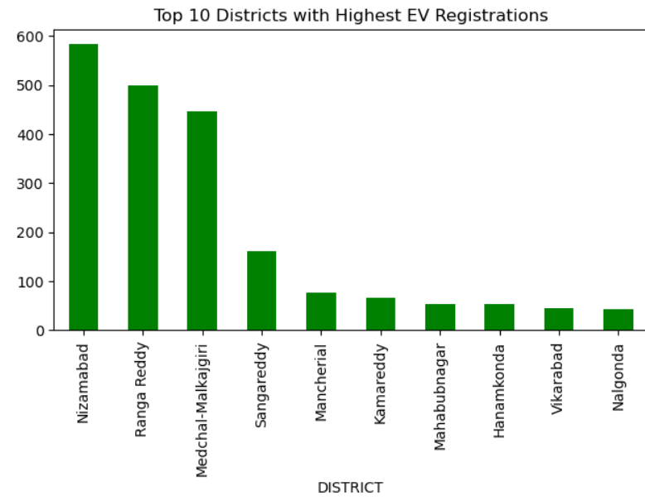
EV (EDA) – 2019

Slide 9
SQL AND POWER BI DASHBOARD LINKS
https://drive.google.com/uc?export=download&id=1Nsa4opl40hGRIbP5VXF0mbwy-7Y11GXQ
https://github.com/vedameghana03/Data-Driven-Insights-on-Telangana-Vehicle-Market-2019-2025-

Slide 10

Electric Vehicle Market Analysis (2019–2025)

Slide 11
EV Dataset Overview & Preparation
🧹 Data Filtering & Cleaning Steps:
1. Filtered dataset where Fuel = Battery to isolate EV records
2. Standardized Color column,
Brand names
3. Created District column (using mapping)
4. Extracted Year and Month from registration date
New Feature: Vehicle Class Category
Defined clear classes for EVs based on usage and size:2W, Bus/Passenger, 4W, 3W Goods, 4W Goods,2W Commercial, 3W Commercial, Agriculture/Heavy, Unknown
🗑 Dropped Unnecessary Columns
Removed: Model Description, Vehicle Class, Make Year, Seat Capacity, Second Vehicle, Temporary Reg. No, Category, Maker Name, From Date, To Date
✅ Time Period:Analysis covers Jan 2019 to June 2025

Slide 12
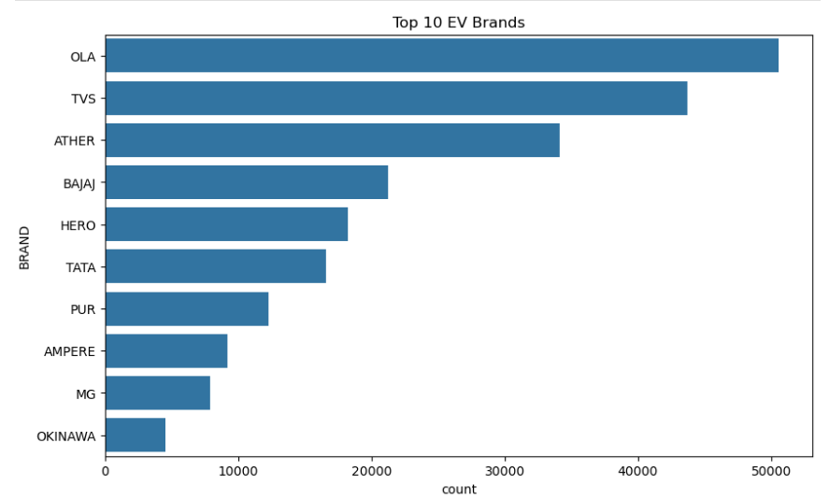
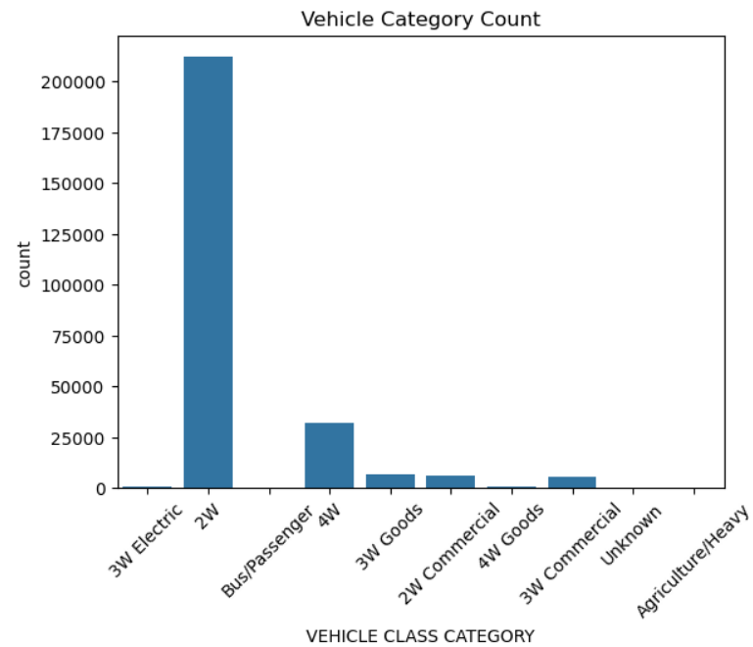
EV Analysis – EDA (2019–2025)

Slide 13

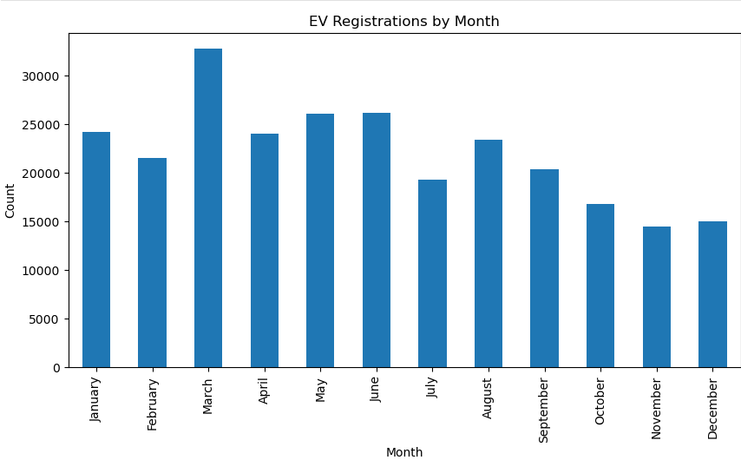
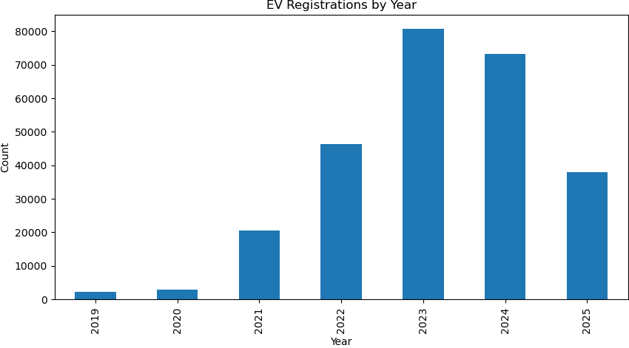

Slide 14
EV ML Forecast – Monthly Registrations (2025–2026)
Objective:
Forecast total EV registrations per year using 2019–2025 actual data

Slide 15
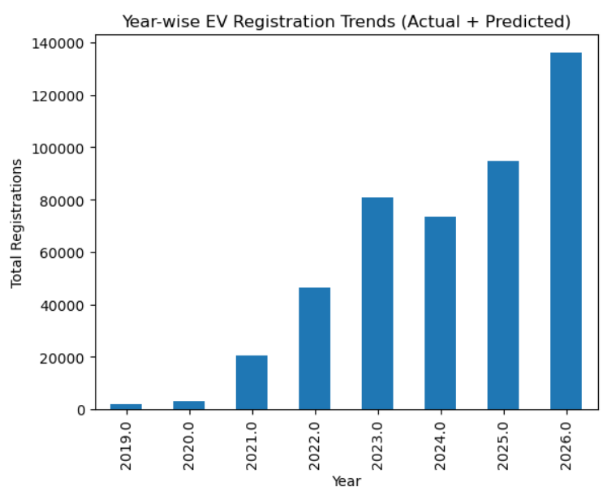
LINEAR REGRESSION
STEP 1: Data Preparation
Filtered EV data (Fuel = Battery)
Grouped EV registrations by Year
Created:
Input feature: YEAR
Target variable: Total EV Registrations
Dataset: 2019 to June 2025 (partial)
STEP 2: Modelling
Model used: Linear Regression
Train-Test Split: 80% train, 20% test
Forecasted for: 2025 (full year)2026
STEP 3: Evaluation Metrics
MAE = 1599.6
RMSE = 1827.7
R^2 = -2.41 (Model didn’t generalize well)
STEP 4: PREDICTION
Prediction Output
2025 Forecast: ~94,000 Ev’s
2026 Forecast: ~1.38 lakh Ev’s
Showed strong upward trend from previous years

Slide 16
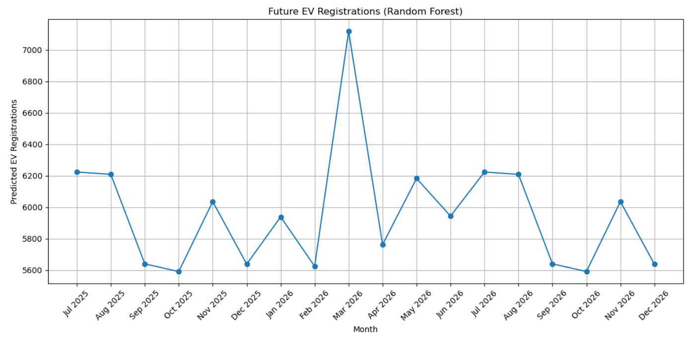
RANDOM FOREST
STEP 1: Modeling Approach
Features: YEAR, MONTH
Model: Random Forest Regressor with 100 trees
STEP 2: Evaluation
MAE: 748.5
RMSE: 1373.8
R² Score: 0.77 ✅ (better than Linear Regression)
STEP 3: Prediction
Predicted monthly EV registrations from Jul 2025 to Dec 2026
Smooth growth trend observed

Slide 17
EV Forecast – District-wise Predictions for 2026
LINEAR REGRESSION

Slide 18
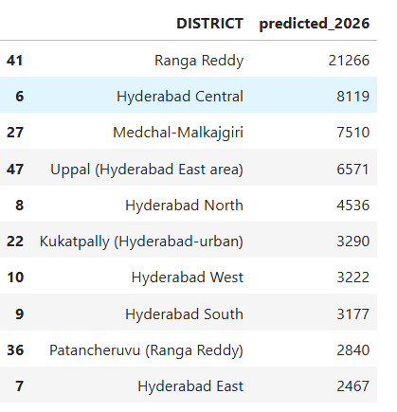
STEP 1: Data Preparation
Loaded the cleaned EV dataset (2019–2025)
Standardized inconsistent district names
Grouped EV data by district and year to get total registrations
Used .pivot() to restructure data (one row per district, columns as years)
Estimated full-year 2025 values using :
Created MONTH and HALF columns (H1 or H2)
Calculated H1_RATIO = H1 / Full Year for past years
Average ratio ≈ 0.48
Estimated 2025: FULL_2025_ESTIMATE = H1_COUNT / avg_ratio
STEP 2: Feature Engineering
Created year-wise growth
features:growth_2020 = 2020 - 2019, etc.
Calculated avg_growth across years for each district
Selected recent features for modeling:count_2023, count_2024, count_2025avg_growth
Defined target variable:target_2026 = count_2025 + avg_growth
STEP 4: Evaluation Metrics
R² Score: 1.0 (Perfect fit)
RMSE: ~1.20e-12 (Very low error)
STEP 5: Prediction Output
Predicted EV registrations for 2026 across all districts
Added column: predicted_2026
Sorted and displayed Top 10 districts based on forecasts
STEP 3: Modeling
Model used: Linear Regression
Train-Test Split: 80/20 using train_test_split()
Fit the model on training data
Predicted target_2026 for each district

Slide 19
This project was built using real vehicle registration data (2019–2025)from the Telangana RTA.
It involved data cleaning, EDA, dashboards, and ML models — all focused on EV adoption patterns and future forecasting.
For complete code, dashboards, and queries:🔗 GitHub: https://github.com/vedameghana03/Data-Driven-Insights-on-Telangana-Vehicle-Market-2019-2025-
THANK YOU

